Slide 1

VT Yelp App
Abdul Omotosho, Nikhil Sowdas, Cristian Valencia,
Antonio Balanzategui

Slide 2
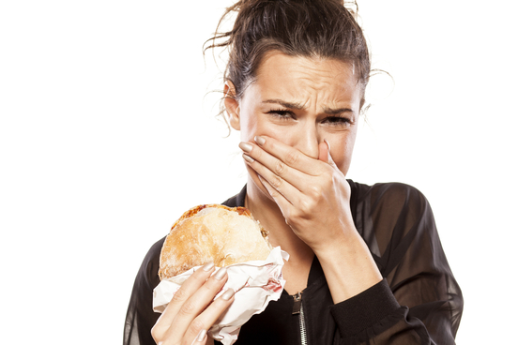
Background
Have you ever wanted to try a new restaurant so badly only to find out the food tasted awful?
This might be the worst feeling in the world
If only there were a way to see what other people
thought of the restaurant before trying it out yourself

Slide 3
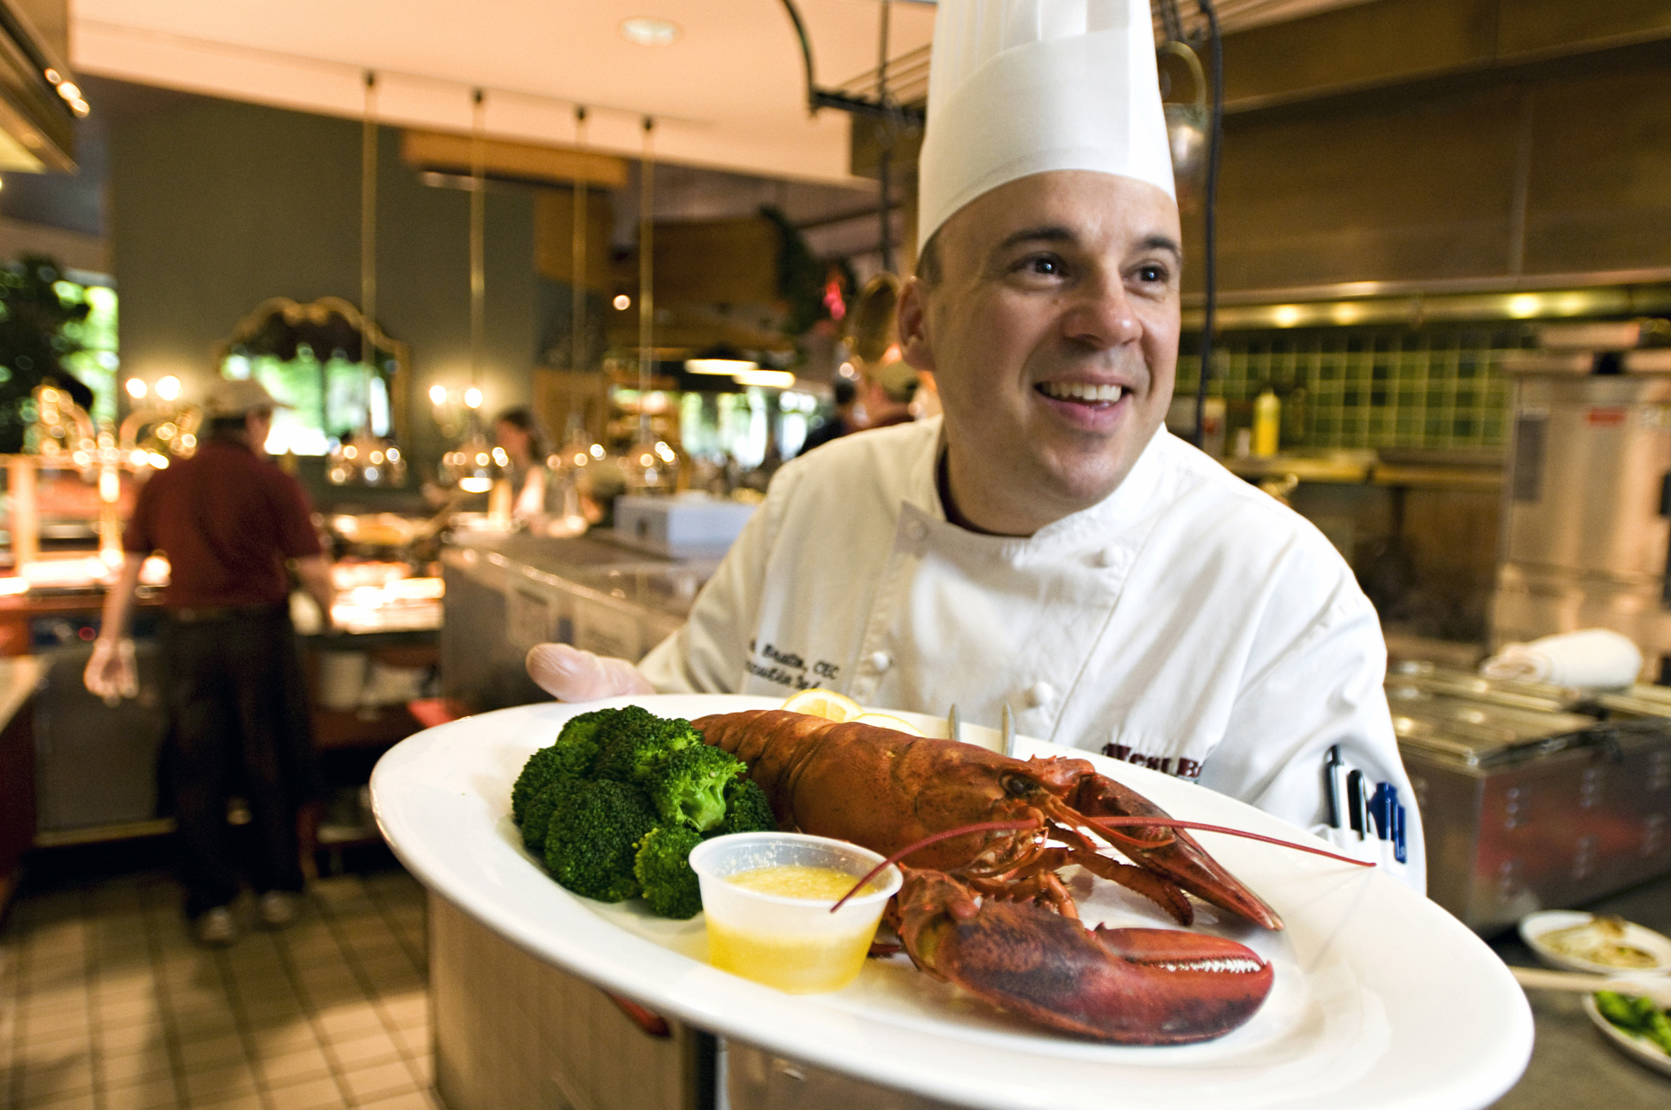
Introduction
Velp- VT Yelp for dining options on and off campus
Virginia Tech’s dining is rated top three consistently why not see what it has to offer?
Never have a bad dining experience here at Virginia Tech again!

Slide 4
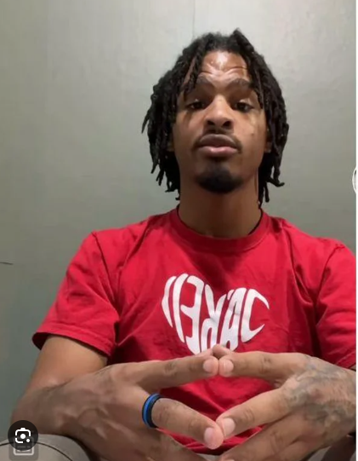
Why is this necessary?
Food delivery services already exist with the ability to rate restaurants.
You’re right!
VT Yelp allows detailed, descriptive reviews for each restaurant and food item specifically!
This also helps businesses!
Items with a written review are 65% more likely to be purchased than one with no reviews
Sales are shown to increase by 20% on average.

Slide 5
Domain
Our app falls under the Food/Food Service domain, however none of us would be considered domain experts. Because of this, we had to conduct separate research into things to consider when working within the Food domain, which include the following…
Working in food industry, information needs to be definitively correct due to the large consequences of it being incorrect
Constant communication with restaurants in order to update hours of operation, menus, and prices as quick as possible
Be able to handle large amount of site visits which apps like Yelp, TripAdvisor, and Foursquare often deal with

Slide 6
Functional Requirements
Review System - All reviews will be verified purchases by verified users
Location - Restaurants will be displayed by proximity to the users current location
Restaurants - All restaurant reviews will be liked to a restaurant page where the user can purchase those items themselves
Searching- Users will be able to search restaurants based on top reviews, names, and cuisine
Notes:
if u want to pad time: Functional Requirements
Review System
Verified Purchases: Only users who have made a verified purchase can leave a review. The system should link with transaction IDs or a QR code verification system.
Verified Users: All users will need to sign up and verify their student ID or email addresses.
Rating Scale: 1-5 star rating along with text feedback.
Review Moderation: A system to flag or review suspicious or harmful content.
Location
Proximity Based: Use the device’s GPS to sort restaurants based on proximity.
Manual Input: Users should also be able to manually input a location.
Map View: Display restaurants on a map with clickable pins.
Restaurants
Restaurant Page: Each restaurant will have a profile page with reviews, menus, and a 'purchase' option.
Direct Purchase: Users can purchase items directly through the app, with options for delivery or pickup.
Menu Customization: Restaurants can update their menus in real-time.
Searching
Top Reviews: Sort restaurants based on average review score.
Names: Search by restaurant name.
Cuisine: Filter by cuisine type (American, Chinese, etc.)
Technologies/Methods
Review System
Backend: Use a database like MongoDB or PostgreSQL to store reviews, user profiles, and transaction IDs.
Verification: OAuth for user identity and an API to the payment gateway to validate purchases.
Location
Backend: A geospatial database like PostGIS.
Frontend: Geolocation APIs to access the device’s GPS location.
Mapping Service: Google Maps API or OpenStreetMap for displaying locations.
Restaurants
Backend: A robust CMS for restaurants to upload their menus, and a database to store these details.
E-commerce Platform: Integration with payment gateways like Stripe or PayPal for direct purchases.
Searching
Backend: Elasticsearch for fast and efficient searching.
Frontend: Filter and sort options in the UI for better user experience.

Slide 7
Non-Functional Requirements
High uptime- The app should be available to users 99% of the time.
Low latency- Users should be able to use the app to search and review as quickly as possible.
Scalability- The app should be able to scale up or down to handle traffic during holidays and weekends.
Usability- Users with special needs should be able to easily use the app as well.

Slide 8

Team Member Responsibilities
Nikhil- Administrator and verification
Antonio - Landing page and order history
Cristian- Review System
Jiham- User and restaurant profiles
Abdul- GPS System and search bar

Slide 9


Potential Challenges
Establishing and maintaining communication with every dining hall at Virginia Tech.
Dining halls are often understaffed with the staff being overworked and underpaid, so we would want to avoid causing further burdens for the staff
Lack of familiarity with the domain
None of us have history of developing apps let alone for the food industry
Designing the layout
We have a lot of features we want to include, so we need to design a layout which incorporates all of our features without looking crowded or overwhelming the user
Maintaining high functionality
As mentioned before, we have many features which perform various functions, so we need to ensure this doesn’t come at the expense of the latency of the app
Accurately verifying users
Ensuring that we are correctly verifying users and preventing misinformation

Slide 10
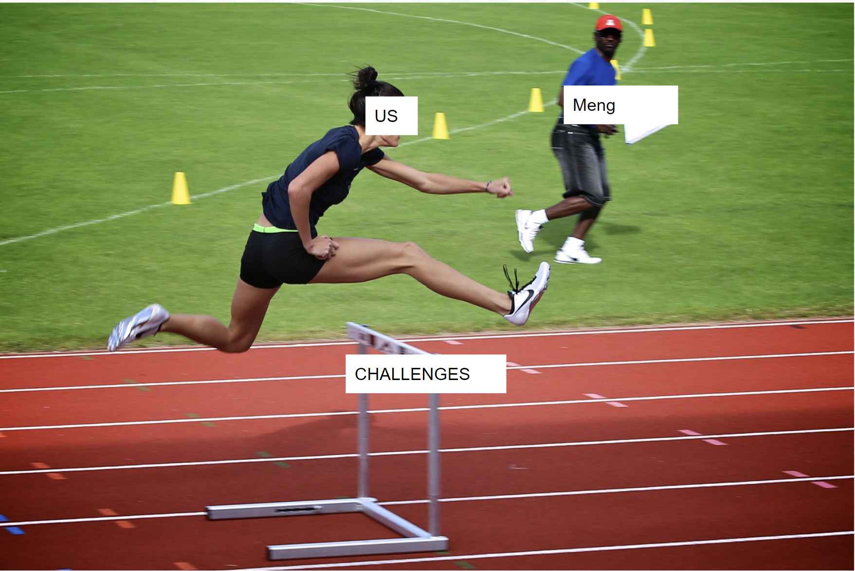
Strategies to Overcome those Challenges
Conduct further research into the domain
Further familiarize ourselves with the common practices used by other companies in this domain and possibly take inspiration from them
Build relationships with restaurants in advance and as early as possible
Plan layout in advance and conduct surveys for user feedback before implementation
Implement multiple level identification
Include multiple design aspects to lower latency such as memory/garbage collection and system buffers

Slide 11

Thank You!

Slide 12

Questions ?

